Slide 1
MetLife Sinkhole Analysis
Michael Andrejco
Devon Bolen
Gina Catellier
John Leary
Caroline Williams
Notes:
All Introduce ourselves

Slide 2
Goal of Analysis
The primary goal of our analysis is to be able to predict the occurrence of a sinkhole within a one mile radius of any given location in Florida.
Weather
Sinkhole?
Population
Yes/No
MODEL
Soil Type
Etc...
Notes:
Michael

Slide 3

Sinkhole Dataset
Provided by
Notes:
Michael

Slide 4
The Data
Collected from various conservation and environmental departments
Dataset features include: Soil Characteristics, Census Data, Weather Impacts, and Historical Florida Sinkhole Data
Target variable: Presence of sinkhole within a 1-mile radius
Notes:
Michael

Slide 5
Cleaning up the Data
Removed columns that contain more than 75% nulls
In categorical columns replace any nulls with the word ‘Unknown’
Impute any nulls in numerical columns with the mean of that column
Check for and remove outliers from the dataset
Outliers were defined as values that fall outside of three standard deviations
Transformed target variable into a binary target (sinkhole or no sinkhole)
Notes:
Michael

Slide 6
Instant Insights
Notes:
John

Slide 7
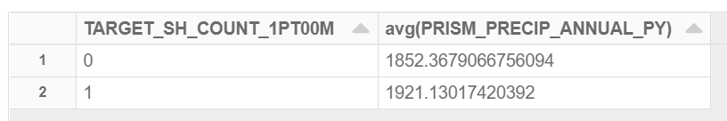
Yearly Precipitation in Florida
Notes:
John
Filtered to higher end > 1700 precip
Average is higher for target yes sinkhole

Slide 8
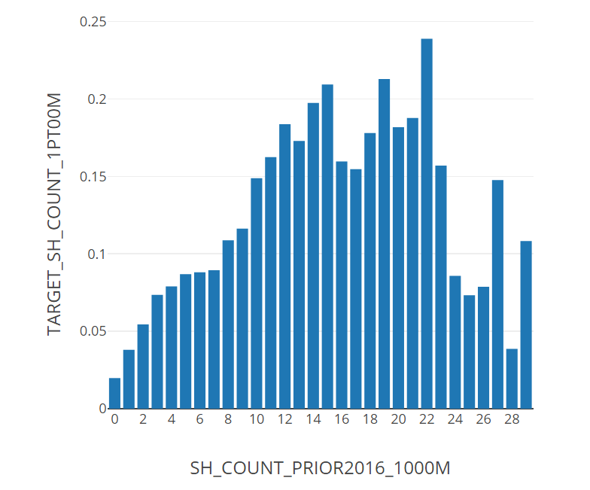
Sinkhole History
Notes:
John
Overall trend is positive, more sinkhole history has more current sinkhole

Slide 9
Sinkholes
Plotted by
Year
Dataset
Notes:
John
There has not been a significant rise or decline in sinkholes over the last 4 years. However, there are locations where sinkholes have occurred repeatedly between 2016 and 2019; most significantly, Tampa and Central Florida.

Slide 10
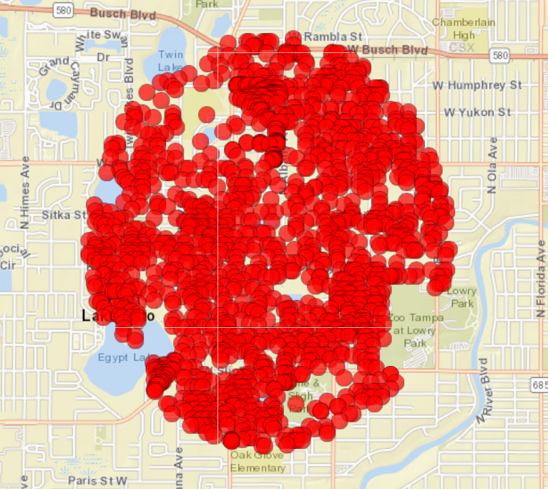
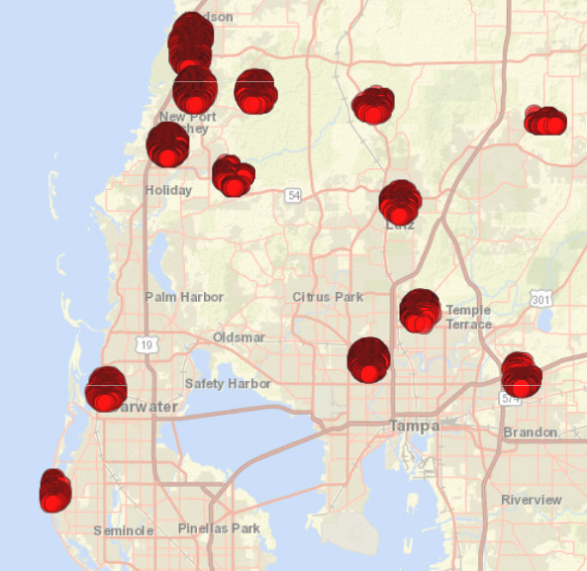
High Risk Area
Tampa
Notes:
John
Here is a sample of the metlife data from Tampa in 2019. The city is known for having a high number of sinkholes. Unfortunately, this means densely populated areas are most affected. The exhibit to the right is an example of how many homes fall into a 1-mile radius of a reported sinkhole. This type of circumstance is very important for MetLife to consider when writing policies.

Slide 11
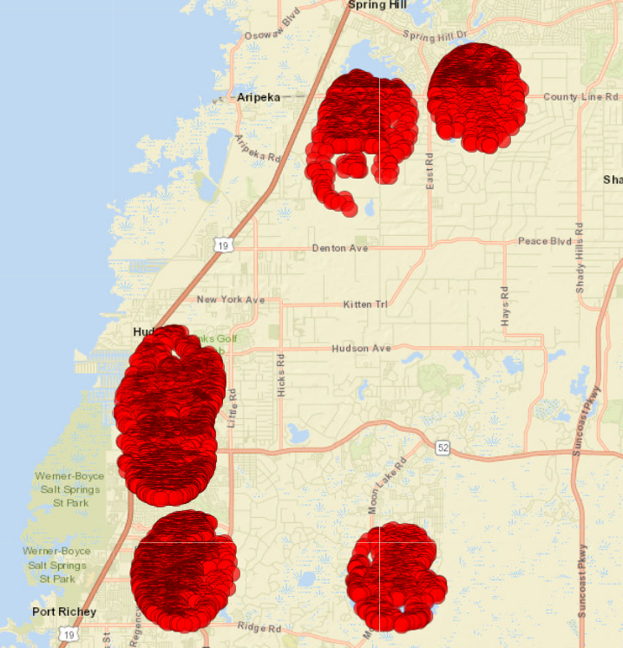
Gulf Coast
The
Here is one example of how water coming in from the coastline has a massive impact on inland water formations. This also plays a significant role in causing accelerated erosion to limestone in the area.
Notes:
John

Slide 12
Model Creation

Slide 13
Model Building Process
Sinkhole
Data
Feature
Engineering
Insights
Modeling
Notes:
Gina

Slide 14
Feature Selection & Engineering
We wanted to build models that contained:
Soil data and aquifer data
Then use combinations of the following to see what features were the best:
Prior years population
Housing density
Any prior existing sinkholes
Weather/precipitation data
Notes:
Gina

Slide 15
Feature Lists
Feature List #1
Feature List #2
Feature List #3
Aquifer Data
Some Population Data
Housing density
Some Soil Component Data
AWS, TKO, SOCO, NCCPI
Some Precipitation Data
Monthly
Some ratio of prior years
Aquifer Data
All Population Data
Housing density
Home values
Lots of Soil Component Data
AWS, TKO, SOCO, NCCPI
All Precipitation Data
Monthly
Ratio of prior years
Aquifer Data
All Population Data
Housing density
Home values
Lots of Soil Component Data
AWS, TKO, SOCO, NCCPI
Very little Precipitation Data
Ratio of prior years
Notes:
Gina

Slide 16
Model Creation With Imbalanced Data
First analysis of our data showed that it was highly imbalanced
Used an oversampling method to duplicate 40% of the minority class
Functions created to run with the models:
Depiction of model performance
Depicting feature weights
Probability selection
Cumulative lift/gain charts
Notes:
Gina

Slide 17
Model Results

Slide 18
Initial Modeling Results
Logistic Regression - Worst Performer
Poor precision and recall scores
Substandard lift scores
Random Forest - Good Performer
Poor lift scores
Gradient Boosted Tree - Best Performer
High precision scores
Good lift scores
Notes:
Devon
Ran 3 models of which GBT was best

Slide 19
Gradient Boosted Tree Results
Feature List 1:
Precision = 89.5%
Recall: 7.7%
Lift: 6.46
Feature List 2:
Precision = 86.18%
Recall: 8.8%
Lift: 6.45
Features
Aquifer Data
All Population Data
Housing density
Home values
Lots of Soil Component Data
AWS, TKO, SOCO, NCCPI
Very little Precipitation Data
Ratio of prior years
Feature List 3
Precision = 98.78%
Recall: 3.7%
Lift: 5.07
Notes:
Devon
We ran all of these model against each feature list
Precision of 98.78% represents the % of proportion of positive identifications that were actually correct. Its corrent 98.78% of the time.
Recall of just under 4% which looks at proportion of actual positives identifies correctly. In this case, Able to correctly identify 4% of sinkholes which is good considering low proportion of sinkhole presence to begin with.
Lift of 5 before cross validation

Slide 20
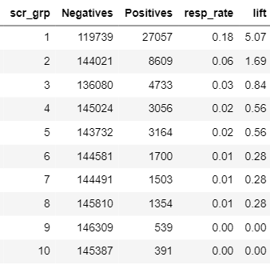
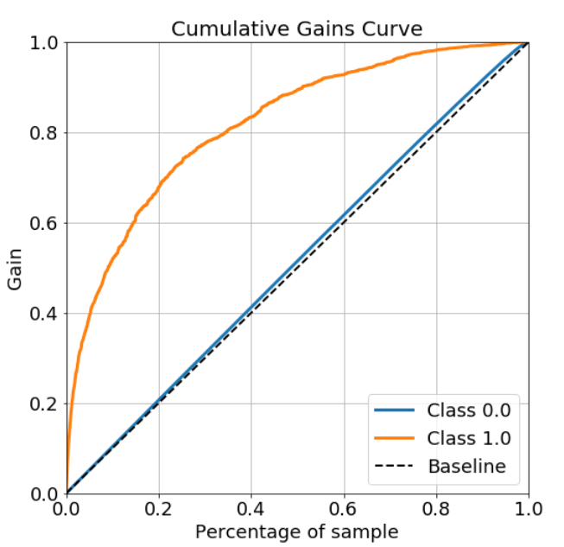
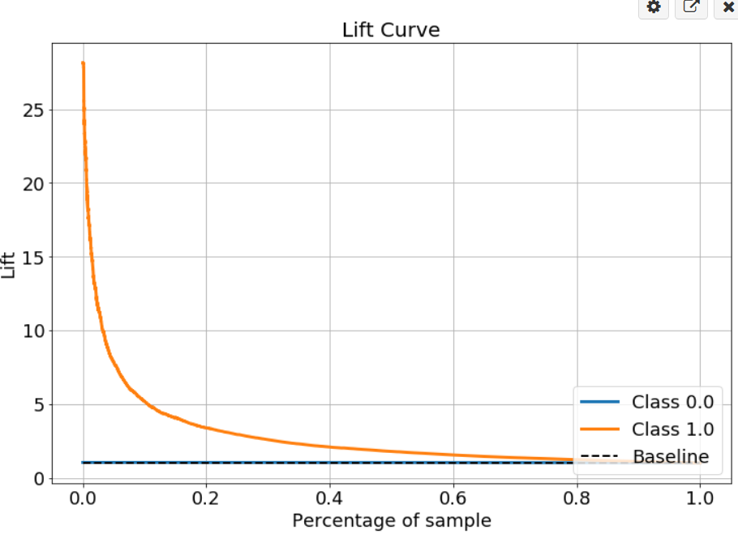
Model Results for Feature List #3
A
B
C
Reported data from gradient boosted tree model with feature list 3. A. Lift chart from modeling results with feature list 3. B. Cumulative gains curve. C. Cumulative lift curve.
Notes:
Devon
This essentially ranks or rather scores our validation metrics and sorts on highest scores.
If you look at first group #1 basically saying that the first 10% or so is a better group to target because you can achiece a response rate of 0.18 which is 5 times higher than what you would get if you were targeting the entire population of data as a whole, hence the lift of 5.07. Where you would not want to write policy here
Gain chart: if you target 10% sample, the gain is about 50% which means that 50% of those targets will be covered by just sampling this 10% of our data

Slide 21
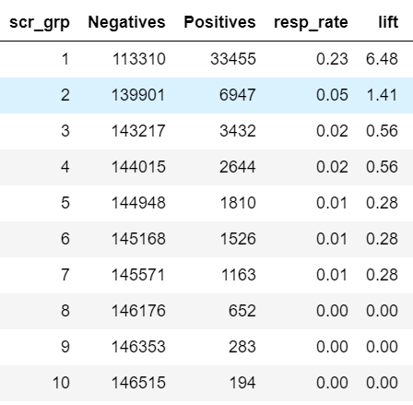
Cross Validation Results - Feature List #3
After performing cross validation on the model, we saw significantly higher lift results
Notes:
Devon
Targeting this 1st sample group of 10% would increase respone rate to .23%, 6.48x higher

Slide 22
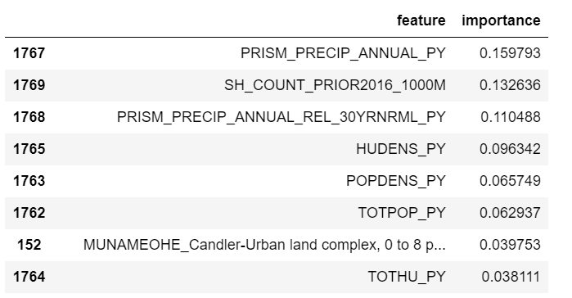
Feature Weights and Model Insights
Soil and Aquifer data alone were not enough to make any accurate predictions
Weather and Population features were later added to the training data which improved the model significantly
Whether or not there was a prior existing sinkhole mattered for predictions
Feature importance data for top features in feature list #3
Notes:
Caroline

Slide 23
Summary of Results
In conclusion the biggest predictors of sinkholes were soil type, weather impacts, and population density.
Based on the data provided by MetLife, our model is able to make a solid prediction as to whether or not a sinkhole will occur.
Notes:
Caroline

Slide 24
Recommendations
MetLife should be careful when writing policies for decile groups one and two from the lift chart
These docile groups have a higher percentage of a sinkhole occurring
MetLife should not be as worried with writing policies for other decile groups
Notes:
Caroline

Slide 25
THANK YOU - ANY QUESTIONS?
Notes:
Caroline

